Slide 1
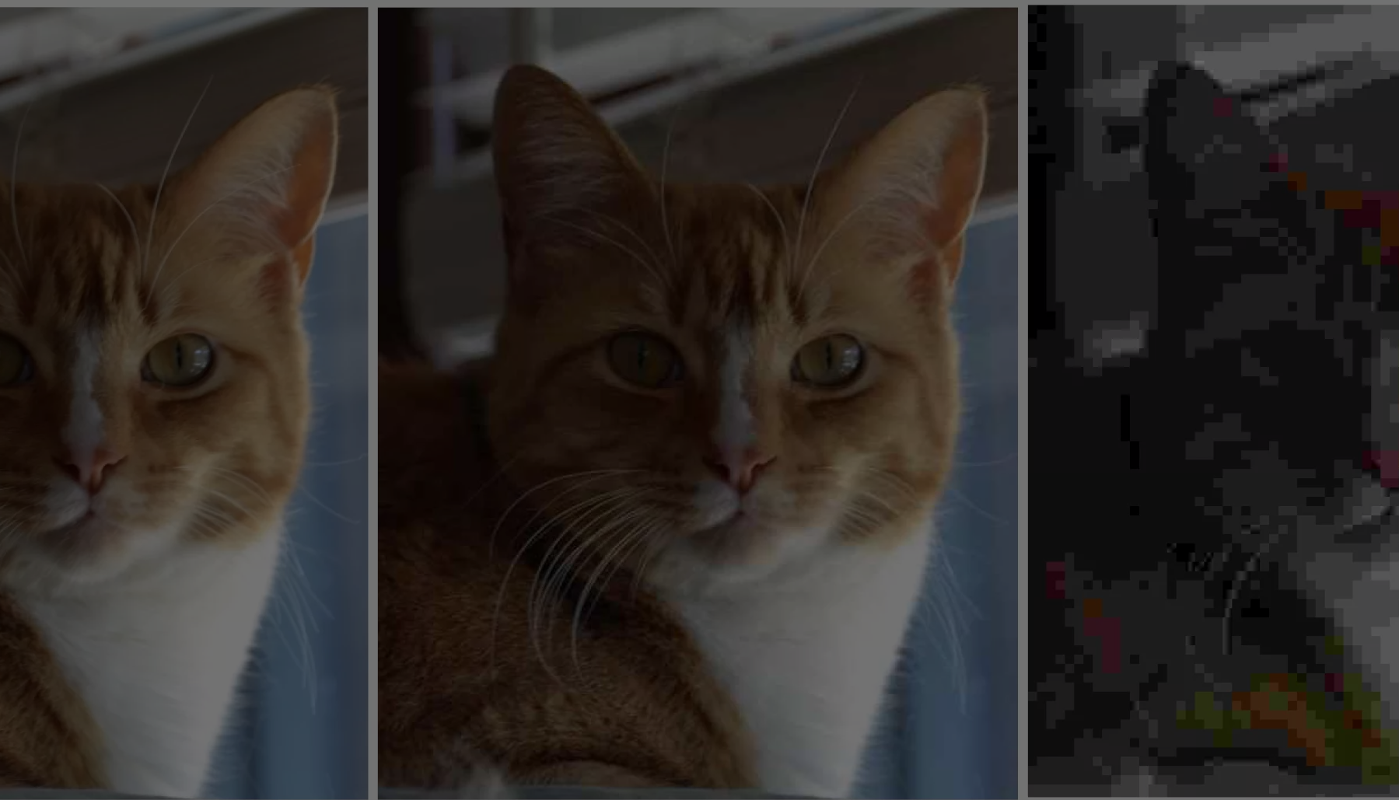
MPEG-1 Video Compression
Group Members
Lucky Douangmanivong 011986182 luckd@cpp.edu
Ryan White 011906713 rswhite@cpp.edu
Jaehyun Kim 011457706 jaehyunkim@cpp.edu
Trey Nguyen 011666226 tmnguyen@cpp.edu
Jaime Castro 011263525 jaimecastro@cpp.edu
Eric Ly 010887591 egly@cpp.edu
Professor Mohamed El-Hadedy, CPP ECE department
Notes:
Andrew

Slide 2
Introduction/motivation
We are using software (Python) and hardware (FPGA) in order to perform video compression into MPEG-1 format. Then, we compare the two processes and see which one is faster. This will help us see the differences of software and hardware when performing the same task as well as helping us learn how to implement tasks in hardware and software.
Notes:
Andrew

Slide 3
What is MPEG-1 Format
MPEG-1 is a video and audio compression standard that was created in 1992 to compress VHS video and audio. This would allow for VHS media to be put on more platforms such as cable TV and video CDs. The MPEG-1 format would compress the video and audio to around 1.5 Mbits/s which allows for these product to be used in a large amount of products. MPEG-1 is still a popular format today and is widely known for popularizing the MP3 audio format. This compression format was also extended to MPEG-2, MPEG-3, etc.

Slide 4
Contribution
Lucky - Team Organization, Verilog/HDL Implementation, Pynq Hosting
Ryan - Software implementation, Pynq programming, Data Acquisition
Trey - Documentation Oversight, Data Acquisition, Team Organization
Jaehyun - Documentation Oversight, Data Acquisition, Team Organization
Jaime - Documentation (Report), Formatting, Code Solutions
Eric - Documentation (Presentation), Formatting, Code Solutions

Slide 5
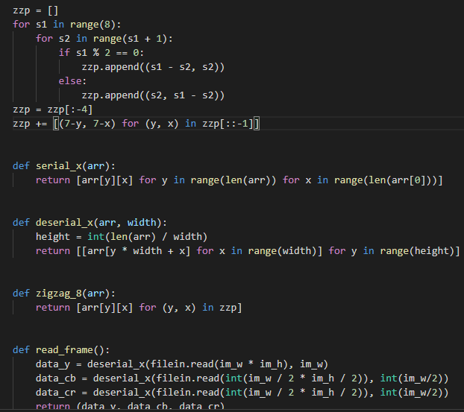
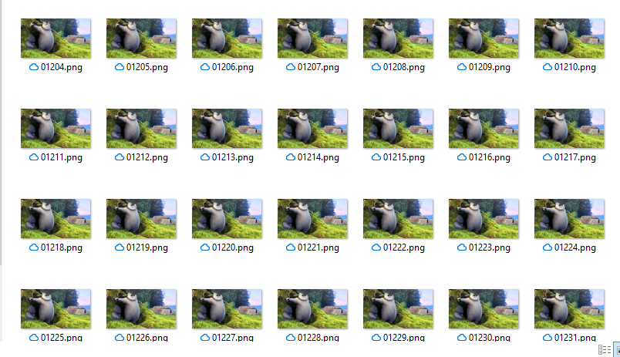
Software (PC)
Used a PC as a base with which we will compare our hardware implementations against
Used Python code to compress 24 images as MPEG-1 I- Frames
Notes:
Ryan

Slide 6
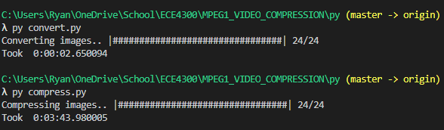

Software Results
RGB to YCbCr conversion time
3 seconds
Compression time
3 minutes 44 seconds
Total Time
3 minutes 47 seconds
Notes:
Ryan

Slide 7
Hardware (Verilog)
Goal: Use FPGA in order to compress video to MPEG-1 I-Frames
Implemented existing Verilog code to run the same 24 frames as the software.
Existing Code is actually made to do Jpeg compression
Jpeg Compression is same as MPEG-1 I-Frames
Wrote Testbench to take RGB data from Text File
Only utilized Testbench and not bitstream implementation
Difficulty creating ROM to hold all RGB values for image stream
Difficulty interfacing ROM with JPEG modules
Notes:
Lucky

Slide 8
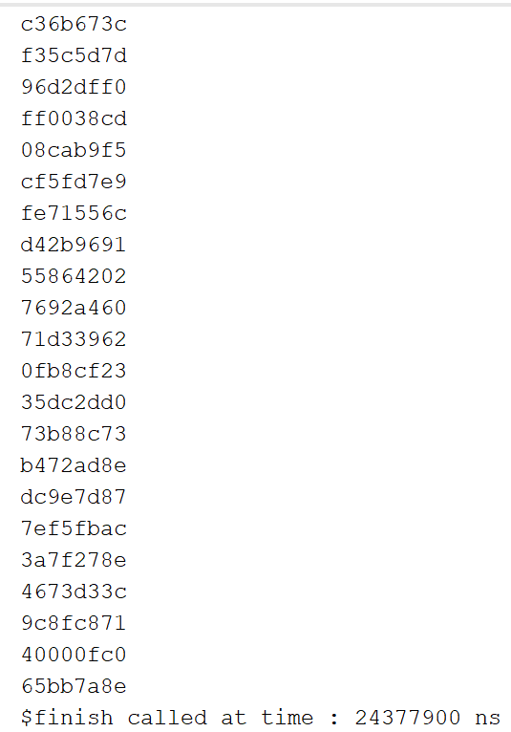
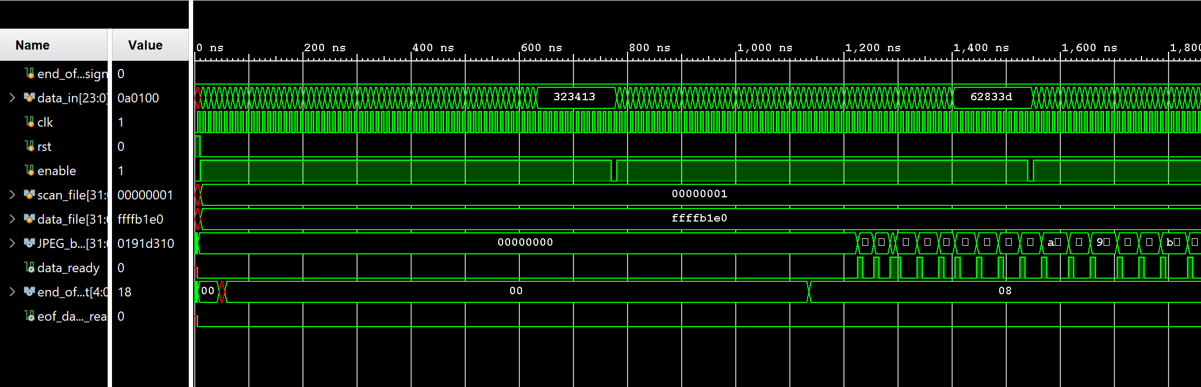
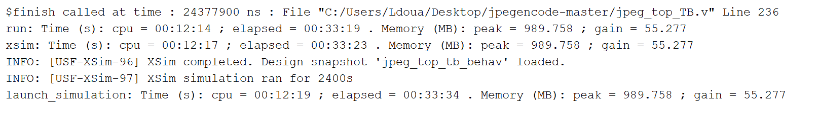
Simulation Results
Cpu Time: 12 minutes 19 seconds
Total Elapsed Time: 33 minutes 34 seconds
Peak Memory Usage: 989.76 MB
Hardware Estimated to take 0.0243779 seconds
Notes:
Lucky

Slide 9
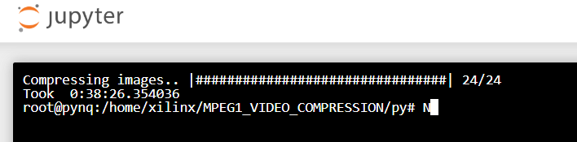
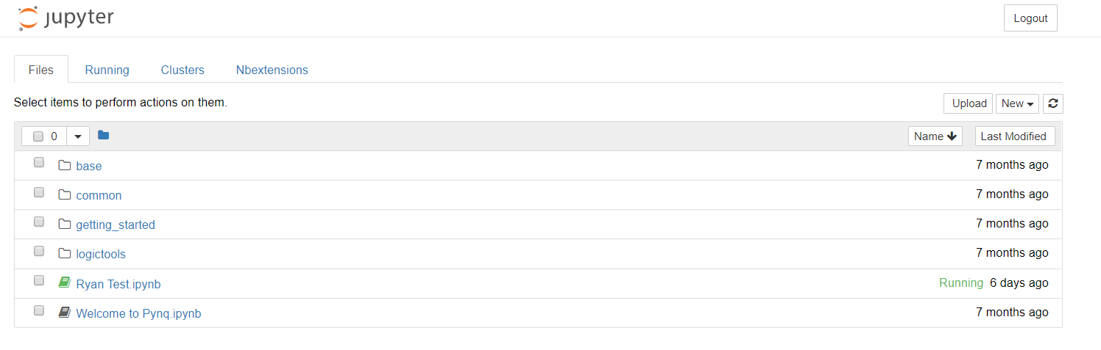
Hardware (Python)
Used Pynq Z1 FPGA to implement same Python code that was run on windows desktop.
Port Forwarded to allow all members to access the Jupyter network
Total compression time:
38 minutes 26 Seconds
Notes:
Trey

Slide 10
Problems/Solutions
Finding time to meet with everyone and collaborate due to Quarantine.
Implementation of Verilog code on physical board
Solution: Create ROM with frames stored in it
Solution: create UART serial communication to stream RGB values
Notes:
Jaime

Slide 11
REFERENCES
[1] A. Davis, An Overview of Video Compression Algorithms, February 3, 1998, Accessed on: April 11, 2020. [Online]. Available: https://www.eetimes.com/an-overview-of-video-compression-algorithms/#
[2] F. Gedegast, MPEG-FAQ: multimedia compression, June 02, 1996, Accessed on: April 8, 2020. [Online]. Available: https://ieeeauthorcenter.ieee.org/wp-content/uploads/IEEE-Reference-Guide.pdf
[3] H. Purnhagen, MPEG-1: coded storage of sampled sound waves, November 07, 2001, Accessed on: April 8, 2020. [Online]. Available: https://sound.media.mit.edu/resources/mpeg4/audio/faq/mpeg1.html
[4] Karwowski, Damian & Grajek, Tomasz & Klimaszewski, Krzysztof & Stankiewicz, Olgierd & Stankowski, Jakub & Wegner, Krzysztof. (2017). 20 Years of Progress in Video Compression – from MPEG-1 to MPEG-H HEVC. General View on the Path of Video Coding Development. 525. 3-15. 10.1007/978-3-319-47274-4_1.
[5] MPEG-1, March 12, 2020, Accessed on: April 12, 2020. [Online]. Available: https://en.wikipedia.org/wiki/MPEG-1

